Slide 1
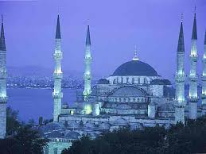
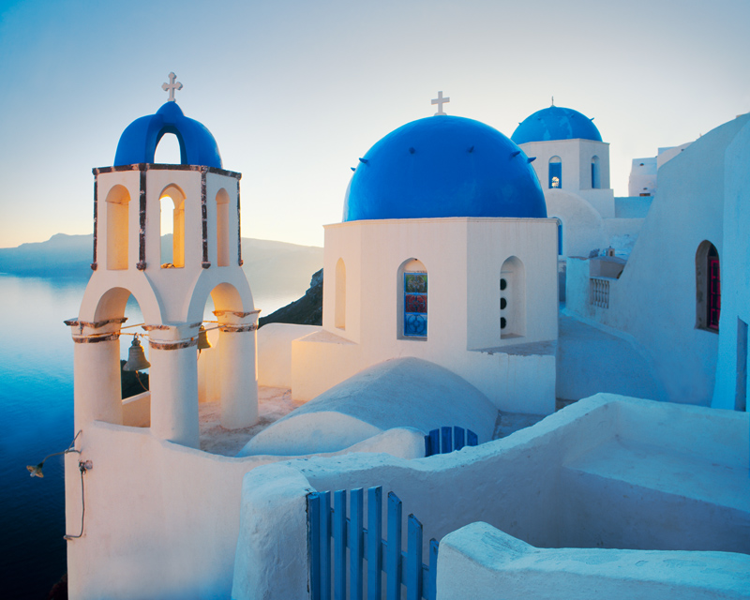
POLITICS OF GREECE & TURKEY
By David Monlux

Slide 2
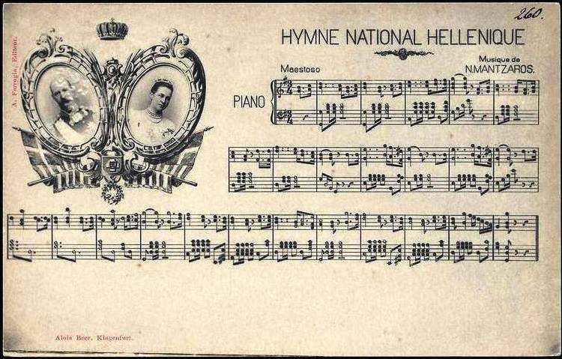
National Anthem of Greece: Hymn to Liberty:
Greek Words: Σε γνωρίζω από την κόψη του σπαθιού την τρομερή, σε γνωρίζω από την όψη που με βια μετράει την γη.
Απ’ τα κόκκαλα βγαλμένη των Ελλήνων τα ιερά, και σαν πρώτα ανδρειωμένη, χαίρε, ω χαίρε, Ελευθεριά!
American English Translations: Version 1: We knew thee of old, Oh, divinely restored, By the lights of thine eyes And the light of thy Sword
From the graves of our slain Shall thy valor prevail As we greet thee again- Hail, Liberty! Hail!
American English Translation Version 2: I recognize you from The fearsome sword's blade , I recognize you from the look who measures the earth in hurry.
Derived From holly bones of Greeks , valiant as before, Hail, oh hail, Liberty!
American English Translation Version 3: I do know thee by the direful cutting edge of thy sword I do know thine eye stare ireful counting fast the lands restored
Thou camest forth off the departed off the sacred bones of Greeks and like erstwhile stouthearted Hail oh hail thee Liberty!

Slide 3
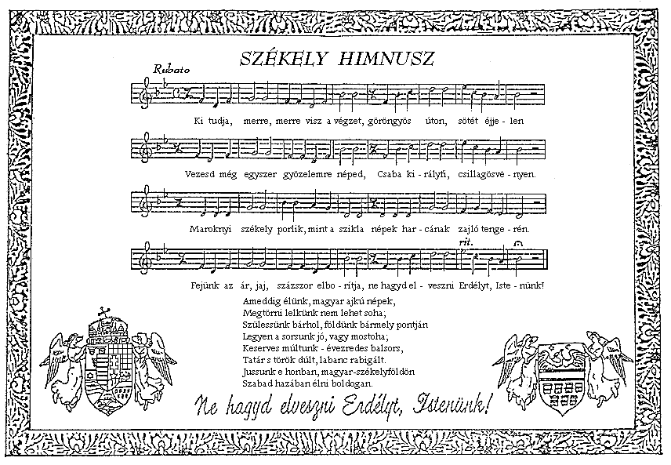
National Anthem of Turkey
Lyrics by M. Akif Ersoy, 1921. Adopted March 12th, 1921. Music composed and added by Zeki Ungor, in 1930.
Verse 1: Fear not, the crimson flag, waving in these dawns will never fade Before the last hearth that is burning in my nation vanishes. That is my nation's star, it will shine; That is mine, it belongs solely to my nation.
Verse 2: Oh coy crescent do not frown for I am ready to sacrifice myself for you! Please smile upon my heroic nation, why that anger, why that rage? If you frown, our blood shed for you will not be worthy. Freedom is the right of my nation who worships God and seeks what is right.

Slide 4
Greece Fast Facts
Total Area: 131,957 square km
Total Coast Line: 13,676
Lowest Elevation: Sea Level.
Highest Elevation: Mount Olympus at 2,917 M
Frequent Earthquakes.
Population: 93% Greek Citizens. 6% Foreign Citizens. 1% Illegal Immigrants.
Religions: 98% Greek Orthodox. 1.3% Islam/Muslims. 0.7% Mix of others.
Population: 10,772,967.

Slide 5
Greek Fast Facts Continued
Obesity Rate: 20.1%
Literacy Rate: 97.3%
Youth Unemployment Rate: 55.3%
Overall Unemployment Rate: 27.9%
Government Type: Parliamentary Republic.
Legal System: Roman Law.
Voting Age: 18.
GDP: $266 Billion.
Population Living below the Poverty Line: 20%.
Inflation Rate: -0.8%
Airports: 77
Heliports: 9

Slide 6
Turkish Fast Facts
Total Area: 783,562 Square KM
Coast Line: 7,200 km
Lowest Point: Mediterranean Sea.
Highest Point: Mount Ararat at 5,166 M
Frequent Earthquakes.
Religions: 99.8% Islam/Muslims. 0.15% Christian. 0.04% Jewish. 0.01% Others.
Population: 80,694,485
Obesity Rate: 27.8%
Literacy Rate: 94.1%
Youth Unemployment: 17.5%

Slide 7
Turkish Fast Facts Continued
Type of Government: Republican Parliamentary Democracy.
Legal System: Civil Cases: Swiss Civil Code. Criminal Cases: European Court of Criminal Rights.
Voting Age: 18
GDP: $1.167 Trillion.
Real Unemployment Rate: 9.3%.
Population Below Poverty Line: 16.9%.
Inflation Rate: 7.6%.
Airports: 98.
Heliports: 20.

Slide 8
Major Political Parties in Greece
Anti Capitalist Left Cooperation for the Overthrow (ANTARSYA) [Petros KONSTANTINOU]
Coalition of the Radical Left (SYRIZA) [Alexios TSIPRAS]
Communist Party of Greece (KKE) [Dimitris KOUTSOUMBAS]
Democratic Left (DIMAR) [Fotios KOUVELIS]
Ecologist Greens [Nikos CHRYSOGELOS]
Golden Dawn [Nikolaos MICHALOLIAKOS]
Independent Greeks (ANEL) [Panayiotis (Panos) KAMMENOS]
New Democracy (ND) [Antonios SAMARAS]
Panhellenic Socialist Movement (PASOK) [Evangels VENIZELOS]
Popular Orthodox Rally (LAOS) [Georgios KARATZAFERIS]

Slide 9
Anti Capitalist Left Cooperation for the Overthrow (ANTARSYA) [Petros KONSTANTINOU]
Formed March 22nd, 2009.
View Point: Mix of Communism and Socialism.
Wants Greece to default on National Debt.
Wants Governments to run all Industry.
Wants to make working more than 35 hours illegal.
Wants everyone to be paid exactly $1,400 Euros annually.
Wants to Abolish the Police.
Wants to grant full Greek Rights to Immigrants & Tourist.
Greek and European Union Parliament Seats: 0.
Regional Government Members: 7 of the 725.
Elected Municipality Officials: 11 out of 12,978.

Slide 10
Coalition of the Radical Left
Formed in 2001. Did not enter an election until 2004.
View Point: 1/3 Libertarian. 1/3 Democratic. 1/3 Socialist.
Greek Parliament Seats: 71 of the 300.
European Parliament Seats: 1 of the 22.
Regional Government Members: 17 of the 725.
Municipality Officials: 0.

Slide 11
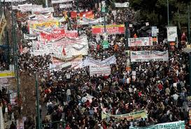
Communist Party of Greece (KKE) [Dimitris KOUTSOUMBAS]
Founded: November 4th, 1918.
View Point: 100% Communist.
Has led and organized most of the recent rallies and sit-in's.
Greek Parliament Seats: 12 of 300.
European Parliament Seats: 2 of 22.
Regional Government Members: 42 of 725.
Elected Municipality Officials: 0 of 12,978.

Slide 12
Democratic Left (DIMAR) [Fotios KOUVELIS]
Founded: June 27th, 2010.
Promotes Individual Rights and Freedoms.
Promotes extreme Government and Business Regulations.
Greek Parliament Seats: 14 of the 300.
European Parliament Seats: 1 of the 22.
Regional Government Officials: 7 of the 725.
Municipality Officials: 0 of the 12,978.
Website: http://www.dimokratikiaristera.gr/

Slide 13
Ecologist Greens [Nikos CHRYSOGELOS]
Founded: December 7th, 2002.
View Points: Environment, Wildlife Preservation and Alternative Fuels.
Greek Parliament Seats: 0.
European Parliament Seats: 1 of 22.
Regional Government Officials: 13 of 725.
Municipality Officials: 52 of 12,798.
Website: http://www.ecogreens.gr/

Slide 14
Golden Dawn [Nikolaos MICHALOLIAKOS]
Founded: Jan 1st, 1985.
View Points: Anti Immigration. Pro Workers Right. Pro Job Creation. Anti Court Trials and Individual Rights. Is rumored as a Terrorist Organization and has had 14 high level Party Officials arrested since 2013 who deny the allegations & are still awaiting Trial. 10 additional ones have been arrested & tried. 4 were found innocent and 6 convicted of Treason.
Greek Parliament Seats: 18 of 300.
European Parliament Seats: 0 of 22.
Regional Government Officials: 1 of 725.
Municipality Officials: 1 of 12,798.
Website: http://www.xryshaygh.com/

Slide 15
Independent Greeks (ANEL) [Panayiotis (Panos) KAMMENOS]
Founded Feb 24th, 2012
View Point: Anti Immigration and Pro Deportation. Promotes Religion taught in Schools. Calls for a massive increase to Education Funding & Teacher Raises. Has a 100% Literacy Rate goal. Calls to make College cost $0 for Students. Calls to pay for the National Debt while rejecting EU & IMF Funding. Wants to cut the Military and Police Force in half.
Greek Parliament Seats: 17 of 300.
European Parliament Seats and Regional Government Officials: 0.
Municipality Officials: 200 of 12,798.
Website: http://anexartitoiellines.gr/

Slide 16
New Democracy (ND) [Antonios SAMARAS]
Founded: October 4th, 1974.
View Point: Conservative.
Greek Parliament Seats: 126 of 300.
European Parliament Seats: 7 of 22.
Regional Government Officials: 261 of 725.
Municipality Seats: 3,000 of 12,798.
Website: http://www.nd.gr/

Slide 17
Panhellenic Socialist Movement (PASOK) [Evangels VENIZELOS]
Founded: September 3rd, 1974.
View Point: Socialist.
Greek Parliament Seats: 27 of 300.
European Parliament Seats: 6 of 22.
Regional Government Officials: 373 of 725.
Municipality Officials: 1,000 of 12,798.
Website: http://www.pasok.gr/portal/

Slide 18
Popular Orthodox Rally (LAOS) [Georgios KARATZAFERIS]
Founded: September 14th, 2000.
View Point: Anti Globalization. Pro Women’s Rights. Calls to withdraw membership from the EU. Calls to increase the Military.
Greek Parliament Seats: 0.
European Parliament Seats: 2 of 22.
Regional Government Officials: 121 of 725.
Municipality Officials: 437 of 12,798.

Slide 19
Major Political Parties in Turkey
Democratic Left Party (DSP) [Masum TURKER]
Democratic Party (DP) [Namik Kemal ZEYBEK]
Felicity Party (SP) [Mustafa KAMALAK]
Freedom and Solidarity Party (ODP) [Alper TAS]
Grand Unity Party (BBP) [Yalcin TOPCU]
Justice and Development Party (AKP) [Recep Tayyip ERDOGAN]
Nationalist Movement Party (MHP) [Devlet BAHCELI]
Peace and Democracy Party (BDP) [Selahattin DEMIRTAS]
Republican People's Party (CHP) [Kemal KILICDAROGLU]
Independent/Non Party Affiliated.

Slide 20
Democratic Left Party (DSP) [Masum TURKER]
Founded November 14th, 1985.
View Point: ½ Socialist and ½ Democratic.
Turkish Parliament Seats: 0.
Municipality Officials: 61 of 2,919.

Slide 21
Democratic Party (DP) [Namik Kemal ZEYBEK]
Founded: 1983.
View Point: Wants to Privatize everything.
Turkish Parliament Seats: 0.
Municipality Officials: 148 of 2,919.

Slide 22
Felicity Party (SP) [Mustafa KAMALAK]
Founded: July 20th, 2001.
View Points: Anti European Union. Favors a Strong Military. Isolationist except with other Middle Eastern Countries. Favors Sharia Law. Favors Media Censorship.
Turkish Parliament Seats: 0.
Municipality Officials: 80 of 2,919.
Website: http://www.saadet.org.tr/

Slide 23
Freedom and Solidarity Party (ODP) [Alper TAS]
Founded: 1996.
View Point: Libertarian. Favors Private Industry, Open Trade Agreements. Pro European Union. Pro Women's Rights. Calls to end entitlement Spending and make Turkey Debt Free in 7 years while increasing the value of their currency and lowering inflation.
Turkish Parliament Seats: 0.
Municipality Officials: 4 of 2,919.
Website: http://odp.org.tr/

Slide 24
Grand Unity Party (BBP) [Yalcin TOPCU]
Founded: January 29th, 1993.
View Point: Calls for Church and State to be one.
Turkish Parliament Seats: 0.
Municipality Officials: 20 of 2,919.
Website: http://www.bbp.org.tr/

Slide 25
Justice and Development Party (AKP) [Recep Tayyip ERDOGAN]
Founded: August 14th, 2001.
View Point: Promotes individual and business freedoms. Very Diplomatic. Lack of Action.
Turkish Parliament Seats: 318 of 550.
Municipality Officials: 688 of 2,919.
2023 Plan.
Website: http://www.akparti.org.tr/english

Slide 26
Nationalist Movement Party (MHP) [Devlet BAHCELI]
Founded: Feb 9th, 1969.
View Point: Pro Turkish and Democracy. Does a bad job of communicating their 2023 vision and does not have enough seats to implement it.
Turkish Parliament Seats: 53 of 550.
Municipality Officials: 506 of 2,919.
Website: http://www.mhp.org.tr/mhp_index.php

Slide 27
Peace and Democracy Party (BDP) [Selahattin DEMIRTAS]
Founded: May 3rd, 2008.
View Point: Minority Rights, Feminism, Kurdish Nationalism and Government Control of Businesses while separating Church and State.
Turkish Parliament Seats: 26 of 550.
Municipality Officials: 97 of 2,919.
Website: http://www.bdp.org.tr/

Slide 28
Republican People's Party (CHP) [Kemal KILICDAROGLU]
Founded: September 7th, 1919 and later disbanded. Reformed on September 9th, 1923. Disbanded in the 1950’s and came back on September 9th, 1992.
View Point: Increase entitlement spending, increase rights of the accused and tax heavily.
Turkish Parliament Seats: 134 of the 550.
Municipality Officials: 499 of 2,919.
Website: http://www.chp.org.tr/

Slide 29
Independent/non Party Affiliated
Turkish Parliament Seats: 14 of the 550.
Municipality Officials: 600 of 2,919.

Slide 30
Infrastructure of Greece
Total Area: 131,957 square km of which 130,647 square km are on land and 1,310 square km are on Water.
Borders Albania(282 km border), Bulgaria(494 km border), Turkey(206 km border) and Macedonia(246 km border).
Coastline: 13,676 km.
Natural Resources: lignite, petroleum, iron ore, bauxite, lead, zinc, nickel, magnesite, marble, salt, hydropower potential.
Population: 10,755,557

Slide 31
Infrastructure of Greece Continued
Clean Drinking Water Access: 99.8% of the entire Population. 100% Urban and 99.4% Rural.
Literacy Rate: 97.3%. Female: 96.3%. Male: 98.4%.
Average years of Schooling: 17 years.
Electricity: 69.5% from Fossil Fuels. 16% from Hydraulic Plants. Renewable Resources: 10.5%. Others: 4%.

Slide 32
Infrastructure of Greece Continued
5,461,000 Landlines.
13,354,000 Cellphones.
150 Private Owned TV Stations.
3 Government Owned TV Stations.
1,500 total Radio Stations. 19 Regional, 7 International and 2 State Owned.
Airports with Paved Runways: 68. Unpaved Runways: 9.
1,329 km pipeline of gas and a 94 km pipeline of oil.
Railroad Tracks: 2,548 km.
116,960 km of road of which 75,603 km are not paved.

Slide 33
Infrastructure of Turkey
Total Area: 783,562 km. Of that 769,632 square km is on land. 13,930 is on Water.
Borders: Armenla(268 km), Azerbaljan(9 km), Bulgaria(240 km), Georgia(252 km), Greece(206 km), Iran(499 km), Iraq(352 km), and Syria (822 km).
Coastline: 7,200 km.
Natural Resources: Coal, iron ore, copper, chromium, antimony, mercury, gold, barite, borate, celestite (strontium), emery, feldspar, limestone, magnesite, marble, perlite, pumice, pyrites (sulfur), clay, arable land, and hydropower.
Population: 81,619,392.

Slide 34
Infrastructure of Turkey Continued
Clean Drinking Water Access: 99.7% of the Population has access to clean drinking water. 100% in Urban Areas and 99.1% in Rural areas.
Literacy Rate: 94.1% of total population. 90.3% of females. 97.9% of males.
Average years of schooling: 14.
Electricity: 64.9% from Fossil Fuels. 32% from Hydroelectric Plants. 3.1% from Renewable Resources.
13,680,000 Land Lines.

Slide 35
Infrastructure of Turkey Continued
Cellphones: 67,680,000.
Televisions: Over 300 privately owned TV & Radio Stations with subject to blackout and censorship at anytime from the Government.
Airports with Paved Runways: 91. Airports with unpaved runways: 7.
Gas Pipelines: 12,603 km. Oil Pipelines: 3,038 km.
Railroad Tracks: 12,008 km.
385,748 km of roads of which 352,268 km are paved and 33,486 are unpaved.

Slide 36
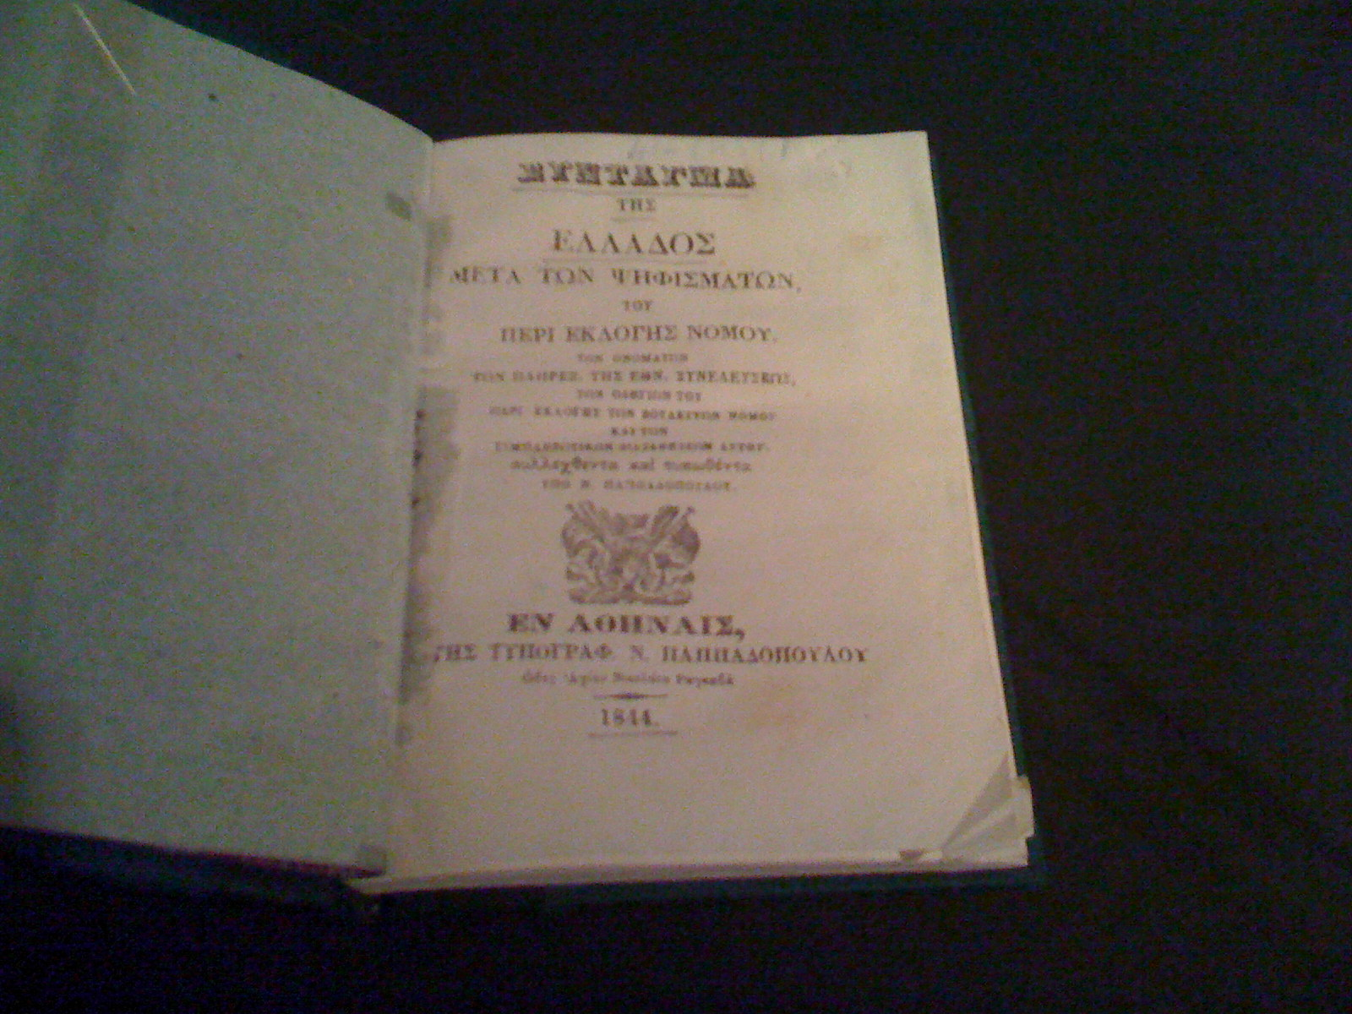
Constitution of Greece
120 Articles.
3 Page Preamble.
Article 3: Relation of Church and State.
Article 4: Equality.
Article 11: The Right of Assembly.
Article 12: The Right of Association.
Article 16: Education, Art, Science.
Article 20: The Right to Legal Protection.

Slide 37
Constitution of Greece Continued
Article 25: Protection and Exercise of the Fundamental Rights.
Article 28: Rules of International Laws and Organizations.
Article 47: Pardon and Amnesty.
Article 87: Judicial Independence.
Article 88: Guarantees of the independence of Justice.
Article 93: Courts.

Slide 38
Constitution of Greece Continued
Article 94: Jurisdiction of Civil and Administrative Courts:
Article 96: Criminal Justice.
Article 97: Mixed Jury Courts.
Article 100A: Legal Council of the State.

Slide 39
Constitution of Turkey
7 Parts
124 Pages.
177 Original Articles
2 Provisional Acts that doesn’t count as part of the Constitution.
2 Page Preamble.
Part 1: II: Characteristics of the Republic: Article 2: “The Republic of Turkey is a democratic, secular and social state governed by rule of law, within the notions of public peace, national solidarity and justice, respecting human rights, loyal to the nationalism of Atatürk, and based on the fundamental tenets set forth in the preamble.”

Slide 40
Constitution of Turkey Continued
Part 1: IV. Irrevocable Provisions: Article 4:
Part 1: IX: Judicial Power: Article 9:
Part 1: X: Equality before the Law: Article 10:
Part 2: Freedom & Religion of Conscience: Article 24.
Part 2: VII: Freedom and though of Opinion: Article 25:
Part 2: IX: Freedom of Science and the Arts: Article 27.

Slide 41
Constitution of Turkey Continued
Part 2: XI: Rights of Freedom and Assembly: Article 33:
Part 2: XII: Provision on the Protection of Rights: Part A: Freedom to Rights: Article 36:
Part 2: XII: Provision on the Protection of Rights: Part B: Principle of Natural Judge: Article 37.
Part 2: XIV: Right to Prove an Allegation: Article 39:
Part 2: XV: Protection of Fundamental Rights and Freedoms: Article 40:

Slide 42
Constitution of Turkey Continued:
Part 2: Right and Duty of Education: Article 42:
Part 2: XI: Protection of historical, cultural and natural assets: Article 63:
Part 2: XVI: Protection of Arts and Artist: Article 64:
Part 3: 2: Superior Bodies of Higher Education: Article 131.
Part 3: D: Publicity of Hearings and the necessity for the justification of verdicts: Article 141:

Slide 43
US Consulates, Embassies and Military Bases in Greece
U.S. Embassy Athens: 91 Vasilisis Sophias Ave 10160 Athens, Greece Phone : 30-210-721-2951 Email: AthensAmEmb@state.gov
United States Consulate General: 43 Tsimiski, 7th Floor 546 23 Thessaloniki GREECE
Telephone: +30 2310 242 905,6,7. Fax: +30 2310 242 927. Public Affairs Fax: +30 2310 242 910
Email: usconsulate@state.gov Web: http://thessaloniki.usconsulate.gov
1 Military Base: NSA Souda Bay in Crete.

Slide 44
US Consulates, Embassies and Military Bases in Turkey
US Embassy in Ankara: American Embassy Ankara 110 Atatürk Blvd. Kavaklıdere, 06100 Ankara - Turkey Phone: (90-312) 455-5555 Fax: (90-312) 467-0019 email: webmasterankara@state.gov
US Consulate Adana: Girne Bulvari No:212 Guzelevler Mah. Yüregir, Adana – TÜRKİYE Phone: (90) (322) 346-6262 Fax: (90) (322) 346-7916 Email: webmaster_adana@state.gov
US Consulate at Istanbul: U.S. Consulate General Istanbul: İstinye Mahallesi, Üç Şehitler Sokak No.2 İstinye 34460 - Istanbul / Turkey Phone: (90) 212-335 90 00 Email: istanbul-webmaster@state.gov
US Consulate in Izmir: Only open on Mondays and Tuesday’s by Appointment only by emailing Izmir@state.gov
Incirlik Airbase:
Izmir Airbase:

Slide 45
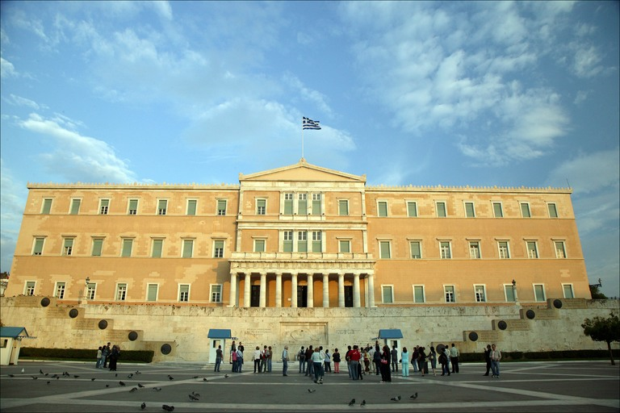
Major Greek Political Issues
EU membership.
National Debt.
Jobs.
Education funding.
Separation of Church and State.
Alleged Scandals.
UN Membership.
Island and wildlife Preservation.
Public Health.

Slide 46
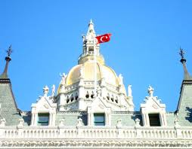
Major Turkish Political Issues
Middle East Alliance verses EU Alliance.
Free Elections and election Fraud.
Police Brutality.
Budget Crisis.
Economic Growth.

Slide 47
Legal Rights Under International Law
Trial by Jury or multiple judge panel unless accused of a misdemeanor in which case one judge.
You must have a defense attorney.
Unless accused of murdering more than 5 people or embezzling over the sum $10 Million, you have the right to Bail. Unless you are deemed a flight risk, high profile or accused of murder they can not charge you for Bail.

Slide 48
Legal Rights under the United Nations
UN Universal Declaration of Human Rights: Article 7: “All are equal before the law and are entitled without any discrimination to equal protection of the law. All are entitled to equal protection against any discrimination in violation of this Declaration and against any incitement to such discrimination.”
UN Universal Declaration of Human Rights: Article 8: “Everyone has the right to an effective remedy by the competent national tribunals for acts violating the fundamental rights granted him by the constitution or by law.”

Slide 49
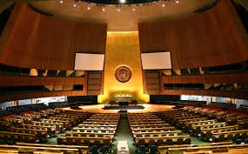
Legal Rights under the United Nations Continued
UN Universal Declaration of Human Rights: Article 9: “No one shall be subjected to arbitrary arrest, detention or exile.”
UN Universal Declaration of Human Rights: Article 10: “Everyone is entitled in full equality to a fair and public hearing by an independent and impartial tribunal, in the determination of his rights and obligations and of any criminal charge against him.”
UN Universal Deceleration of Human Rights: Article 11: “1: Everyone charged with a penal offence has the right to be presumed innocent until proved guilty according to law in a public trial at which he has had all the guarantees necessary for his defence. 2. No one shall be held guilty of any penal offence on account of any act or omission which did not constitute a penal offence, under national or international law, at the time when it was committed. Nor shall a heavier penalty be imposed than the one that was applicable at the time the penal offence was committed.

Slide 50
Legal Rights Under the United Nations Continued
UN Universal Declaration of Human Rights: Article 19: “Everyone has the right to freedom of opinion and expression; this right includes freedom to hold opinions without interference and to seek, receive and impart information and ideas through any media and regardless of frontiers.”
UN Universal Declaration of Human Rights: Article 26: 2: “Education shall be directed to the full development of the human personality and to the strengthening of respect for human rights and fundamental freedoms. It shall promote understanding, tolerance and friendship among all nations, racial or religious groups, and shall further the activities of the United Nations for the maintenance of peace.”
UN Universal Declaration of Human Rights: Article 27: 1: “Everyone has the right freely to participate in the cultural life of the community, to enjoy the arts and to share in scientific advancement and its benefits.”

Slide 51
Legal Rights Under the United Nations Continued
UN Universal Declaration of Human Rights: Article 28: “Everyone is entitled to a social and international order in which the rights and freedoms set forth in this Declaration can be fully realized.”

Slide 52
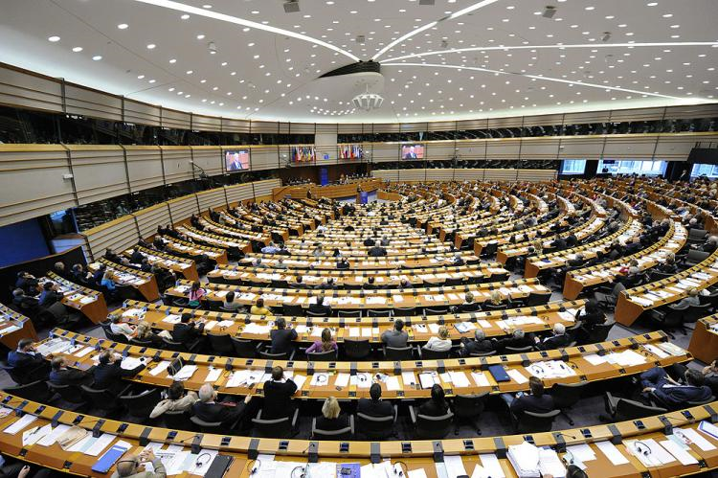
Legal Rights under EU Law
EU Charter: Title 1 Article 2: Right to Life: “No one shall be condemned to the Death Penalty or Executed.”
EU Charter: Title 1: Article 4:Prohibition of torture and inhuman or degrading treatment or punishment : “No one shall be subjected to torture or to inhuman or degrading treatment or punishment.”
EU Charter: Title 2: Article 10: Freedom of thought, conscience and religion: 1: Everyone has the right to freedom of thought, conscience and religion. This right includes freedom to change religion or belief and freedom, either alone or in community with others and in public or in private, to manifest religion or belief, in worship, teaching, practice and observance. 2. The right to conscientious objection is recognized, in accordance with the national laws governing the exercise of this right.

Slide 53
Legal Rights under EU Law Continued
EU Charter: Title 2: Article 11: Freedom of Expression and Information: 1: “Everyone has the right to freedom of expression. This right shall include freedom to hold opinions and to receive and impart information and ideas without interference by public authority and regardless of frontiers.”
EU Charter: Title 2: Article 13: Freedom of the Arts and Sciences: “The arts and scientific research shall be free of constraint. Academic freedom shall be respected.”
EU Charter: Title 3: Article 20: Equality before the Law: “Everyone is equal before the law.”
EU Charter: Title 5: Citizens Rights: Article 41: Right to good Administrations: “4. Every person may write to the institutions of the Union in one of the languages of the Treaties and must have an answer in the same language.”

Slide 54
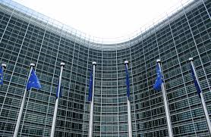
Legal Rights under EU Law Continued
EU Charter of Fundamental Rights: Title VI: Article 47: Right to an effective remedy and to a fair Trial: “Everyone whose rights and freedoms guaranteed by the law of the Union are violated has the right to an effective remedy before a tribunal in compliance with the conditions laid down in this Article. Everyone is entitled to a fair and public hearing within a reasonable time by an independent and impartial tribunal previously established by law. Everyone shall have the possibility of being advised, defended and represented. Legal aid shall be made available to those who lack sufficient resources in so far as such aid is necessary to ensure effective access to justice”
EU Charter of Fundamental Rights: Title VI: Article 48: Presumption of Innocence and Right to Defense: “1. Everyone who has been charged shall be presumed innocent until proved guilty according to law.”
EU Charter of Fundamental Rights: Title VI: Article 50:Right not to be tried or punished twice in criminal proceedings for the same criminal offence: “No one shall be liable to be tried or punished again in criminal proceedings for an offence for which he or she has already been finally acquitted or convicted within the Union in accordance with the law. “

Slide 55
Greek Industry:
Agriculture Products: Wheat, corn, barley, sugar beets, olives, tomatoes, wine, tobacco, potatoes, beef and dairy products.
Industries: Tourism, food and tobacco processing, textiles, chemicals, metal products, mining and petroleum.
Exports: Food, beverages, manufactured goods, petroleum products, chemicals and textiles.
Imports: Machinery, transport equipment, fuels and chemicals.
Trade Partners: Bulgaria, China, France, Germany, Iraq, Italy, Netherlands and Turkey.
Total net from Exports: $30.39 Billion.
Total Payouts for Imports: $50.58 Billion.

Slide 56
Turkish Industry:
Industry: Tourism.
Exports: Apparel, food, textiles, metal manufactures and transport equipment.
Imports: Machinery, chemicals, semi-finished goods, fuels, and transport equipment.
Trade Partners: China, France, Germany, Iran, Iraq, Italy, Russia, UAE, UK & USA.
Total Net from Exports: $167.6 Billion.
Total cost of Imports: $242.9 Billion.

Slide 57
Greek Health Facts
Air & Water Pollution are Growing Concerns.
Very Active Lifestyle.
One of the World’s most Healthiest Diets.
Birth Rate: 8.8 Births per every 1,000 in the Population.
Death Rate: 11 deaths per every 1,000 living people in the Population a year.
Average Life Expectancy: 80.3 years.
Contraceptive Rate: 76.2%
Physician Availability: 6 citizens out of every 1,000 citizens legally practice medicine. 1 out of every 1,000 citizens is a retired or in training doctor. 1 out of every 1,000 citizens practices medicine illegally.
Maximum Hospital Bed Capacity: 4.9 beds per every 1,000 citizens.
Citizens with Access to Clean Drinking Water: 99.8%

Slide 58
Greek Health Facts Continued
Clean Facility Sanitation Access: 98.6% of the total Population.
HIV/Aids Rate: 0.1% of the Total Population.
Obesity Rate: 20.1% of the Total Population with the Majority being in Athens and rising among Children.
Gateway for Heroin Smugglers and 2% of the Total Population has an addiction/problem with heroin and or a family member struggling with it.

Slide 59
Greek Health System
Very few Hospitals.
Free Routine Checkups for Greek Citizens and EU Members.
Long wait list.
Old Facilities.
ALL ER Care regardless of Nationality is FREE.
Free Teeth Cleanings & Vision check ups.
Lots of Rural Clinics with limited resources, but move patients in and out faster than the ER.
Hospital Stays for more than 2 nights, any surgery unless performed in the ER, Eye Procedures and braces cost 4 times as much as in the US.

Slide 60
Turkish Health Facts
Air and Water Pollution in addition to Oil Spills and deforestation are growing concerns.
One of the World’s most healthiest diets.
Birthrate: 16.6 people per every 1,000 people.
Death Rate: 6.12 per every 1,000 people.
Life Expectancy: 73.29 years.
Physician Access: 1.71 physicians per every 1,000 citizens.
Hospital Bed Capacity: 2.5 beds per every 1,000 citizens.
Clean Drinking Water Access: 99.7%
Clean Sanitation Facility Access: 91% of total population.

Slide 61
Turkish Health Facts Continued
Obesity Rate: 27.8% of the total population.
Children Age 5 & Younger Underweight: 3.5%.

Slide 62
Turkish Health System
Article 60 of the Turkish Constitution states: "Every individual is entitled to social security. The State takes the necessary measures to create this confidence and organizes the organization."
Preventive Care is Free at Government Hospitals.
Private Sector is considered to be better.
Health System Reformation underway.
Government and Insurance Companies are contracting with Private Hospitals.

Slide 63
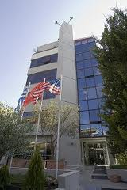
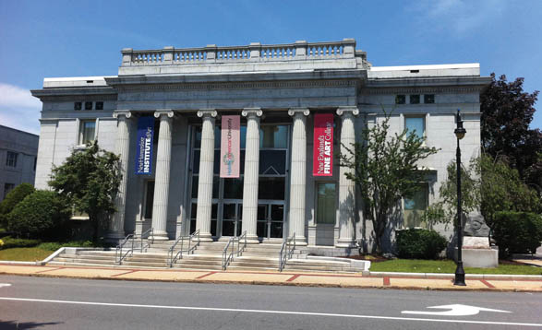
GREEK EDUCATION SYSTEM
4.1% of Total Budget is spent on Education.
Literacy Rate: 97.3%.
Average years of Schooling: 17.
Number of Universities in Greece: 22. 3 Teach all Classes in English.
Number of Career Technology/Vo Techs: 23.
College Attendance Rate: 30%
College Graduation Rate: 66% or 15% of total citizens.

Slide 64
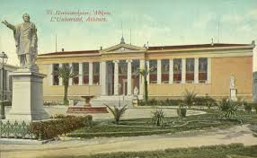
GREEK EDUCATIOPM SYSTEM CONTINUED
OECD Reading Scores: Ranked 31st in the World.
OECD Math Scores: Ranked 39th in the World.
OEDCD Science Scores: Ranked 40th in the World.

Slide 65
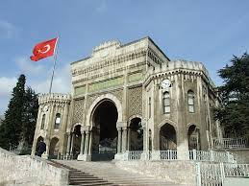
TURKISH EDUCATION SYSTEM
2.9% of Total Budget is spent on Education.
Literacy Rate: 94.1%
Average years of schooling: 14.
3 years in preschool and 8 years in Primary School are legally required by Law.
After Primary School, Parents decide if kid should drop out, go to Technical/Vocational school or attend a normal 3 year High School.
Number of Universities: 175. 104 government run and 71 privately run.
Number of International Students in Turkey: 25,545.
Turkish Government Goal: 100,000 by 2015 and offering very generous scholarships.

Slide 66
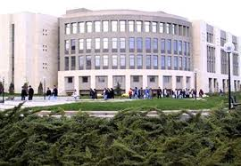
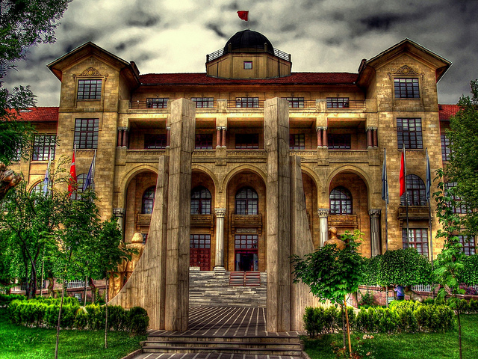
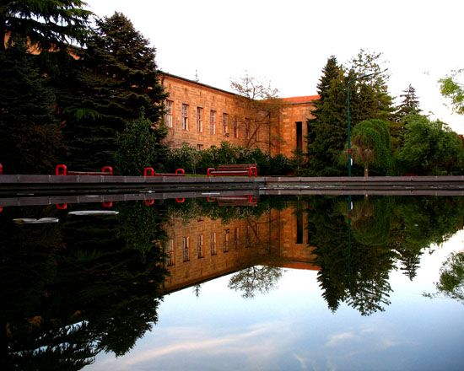
Turkish Education System Continued
OECD Reading Scores: Ranked 41st in all the World.
OECD Math & Science: Ranked 43rd in all the World.
18% of Students Attend College:
9% of all Students in Turkey Graduate College.

Slide 67
Greece’s Economy
GDP: 2013: $266 Billion. 2012: $277.7 Billion. 2011: $296.6 Billion.
GDP Per Capita: 2013: $23,600. 2012: $24,600. 2011: $26,200.
Labor Force: 4,918,000.
Unemployment Rate: 2013: 27.9%. 2012: 24.3%.
Population below the Poverty Line: 20%.
Budget: Takes in $106.2 Billion and spends $111.7 Billion which is 2.7% over Budget.
National Debt: $465.5 Billion.
Extremely High Taxes.
Inflation Rate: 2013: -0.8%. 2012: 1.5%.
Average Loan Rate: 7.1%.

Slide 68
Greece’s Economy Continued
Total amount of Market Shares held by Greek Citizens and Government: 2012: $44.58 Billion. 2011: $33.65 Billion. 2010: $72.64 Billion.
Reserves of Foreign Exchange Currency and Gold Reserves: $7.255 Billion.
Foreign Investment Money put into Greek Markets: $40.1 Billion.
Currency: Euro.

Slide 69
Turkey’s Economy
GDP: 2013: $1.167 Trillion. 2012: $1.124 Trillion. 2011: $1.101 Trillion.
GDP Per Capita: 2013: $15,300. 2012: $15,000. 2011: $14,900.
Labor Force: 27.91 Million.
Unemployment Rate: 2013: 9.2%. 2012: 9.3%.
Population below the Poverty Line: 16.9%.
Budget: Takes in $190.4 Billion and spends $207.9 Billion creating 2.1% over Budget.

Slide 70
Turkey’s Economy Continued
National Debt: $427.122 Billion.
Inflation Rate: 2013: 7.6%. 2012: 8.9%.
Total amount of Market Shares held by Turkish Citizens and the Turkish Government: $308.8 Billion.
Reserve of Foreign Currency & Gold: 2013: $117.6 Billion. 2012: $119.2 Billion.
Foreign Investment put into Turkish Markets: $33.44 Billion.
Currency: Lira.

Slide 71
References
https://www.cia.gov/library/publications/the-world-factbook/
http://www.bbc.com/
Greece and Turkish Political Party Websites
http://lyricstranslate.com/en/greek-national-anthem-%C3%BDmnos-tin-elefther%C3%ADan-%E1%BD%95%CE%BC%CE%BD%CE%BF%CF%82-%CE%B5%E1%BC%B0%CF%82-%CF%84%E1%BD%B4%CE%BD-%E1%BC%90%CE%BB%CE%B5%CF%85%CE%B8%CE%B5%CF%81.html-9
http://www.allaboutturkey.com/anthem.htm

Slide 72
References Continued
http://www.topuniversities.com/where-to-study/asia/turkey/guide
http://www.topuniversities.com/where-to-study/europe/greece/guide
https://www.allianzworldwidecare.com/healthcare-in-greece?choice=en
http://www.allaboutturkey.com/health.htm
http://www.eahm.eu.org/page/show/slug/transforming-the-turkish-healthcare-system/category/turkey
http://eur-lex.europa.eu/LexUriServ/LexUriServ.do?uri=OJ:C:2010:083:0389:0403:EN:PDF

Slide 73
References Continued
http://europa.eu/legislation_summaries/human_rights/fundamental_rights_within_european_union/l33501_en.htm
http://www.ohchr.org/Documents/Publications/FactSheet2Rev.1en.pdf
http://www.ohchr.org/EN/UDHR/Documents/UDHR_Translations/eng.pdf
http://www.hellenicparliament.gr/UserFiles/f3c70a23-7696-49db-9148-f24dce6a27c8/001-156%20aggliko.pdf

Slide 74
References Continued
http://global.tbmm.gov.tr/docs/constitution_en.pdf

Slide 75
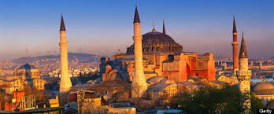
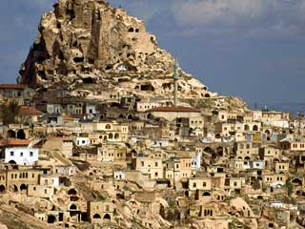
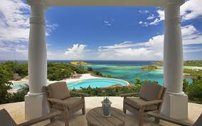
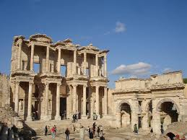
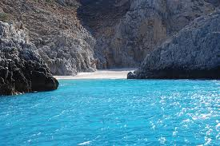
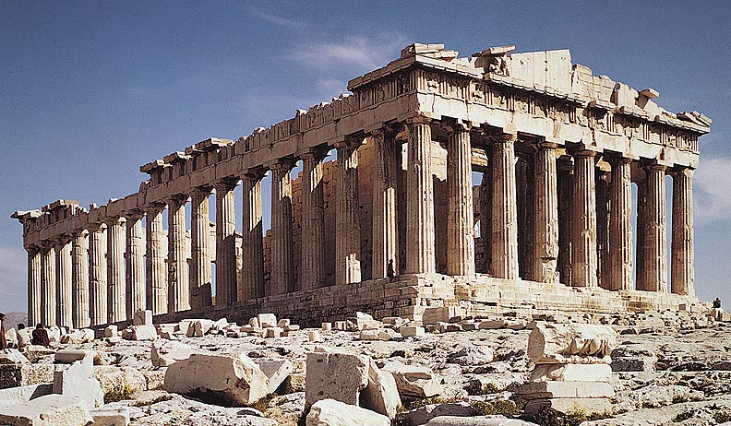
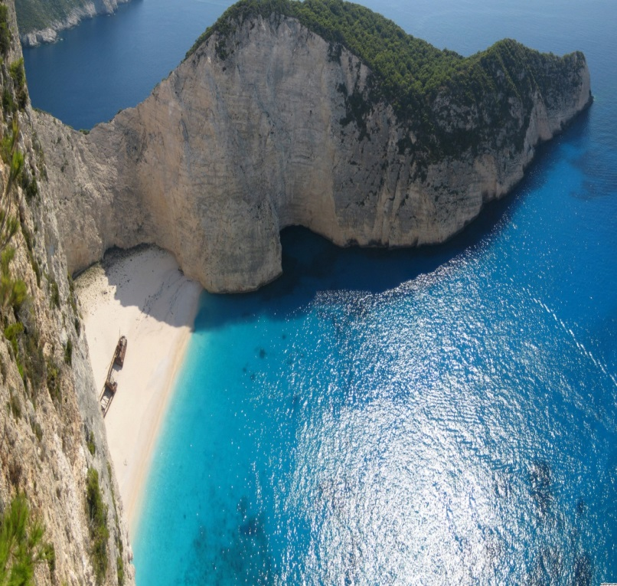
LET OUR TRAVELS BEGIN:
THE END

